Slide 1



Predicting Box Office Earnings with
By Kaleb Erickson

Slide 2
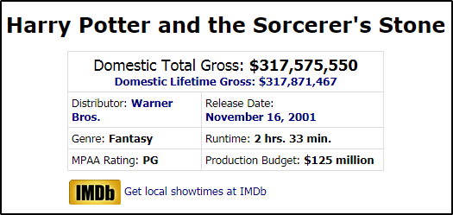
Scraping Box Office Mojo
Only pulled top weekly films from 1981 - 2019
90 second delay between pulls
Issues:
Some films missing values (Disney, old films)
IMDB links to current showtimes
Secondary releases

Slide 3
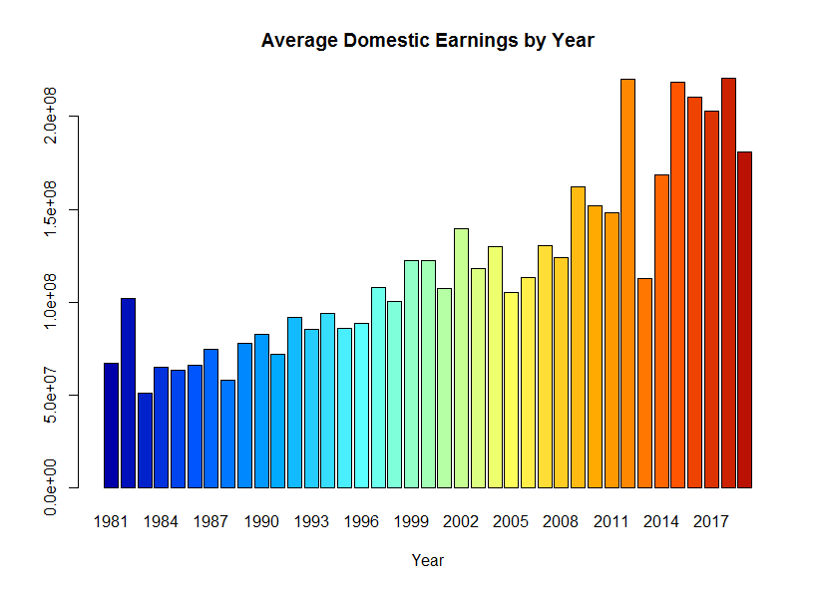
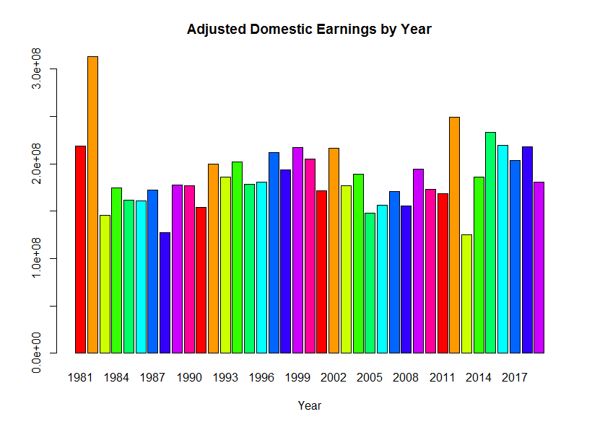
Data Exploration
Dealing with Inflation
Average Price by Year

Slide 4
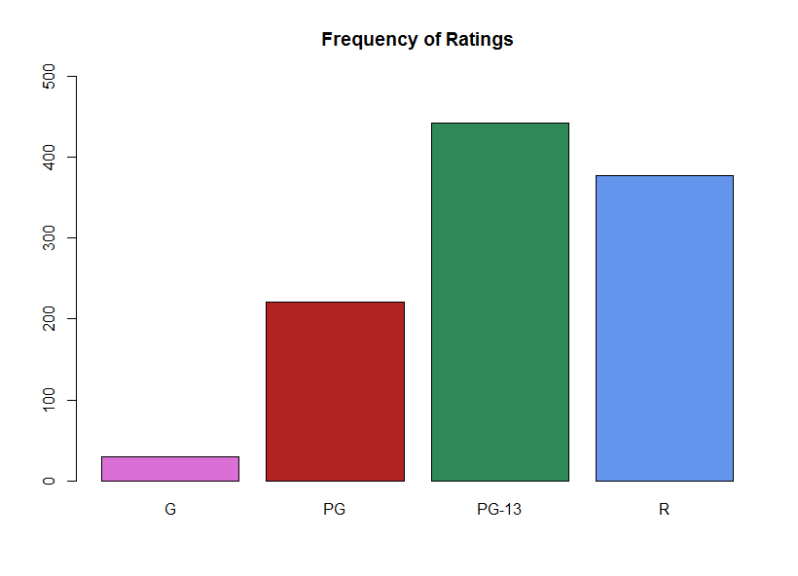
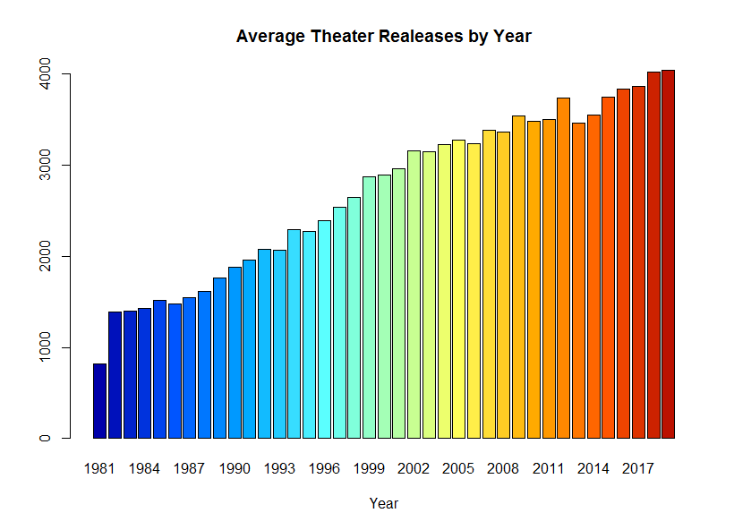
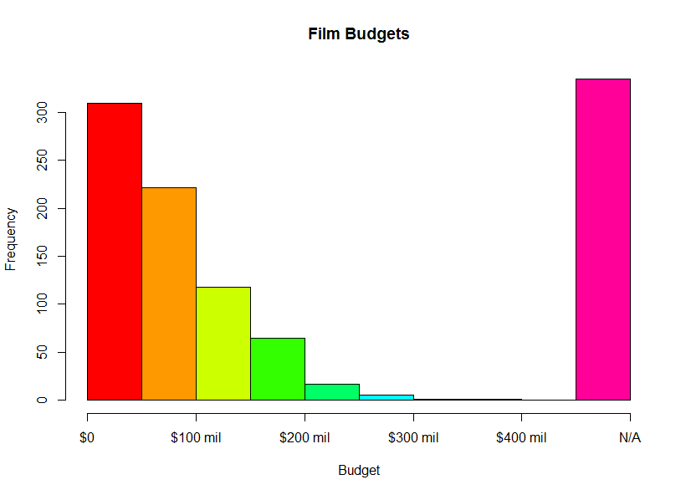
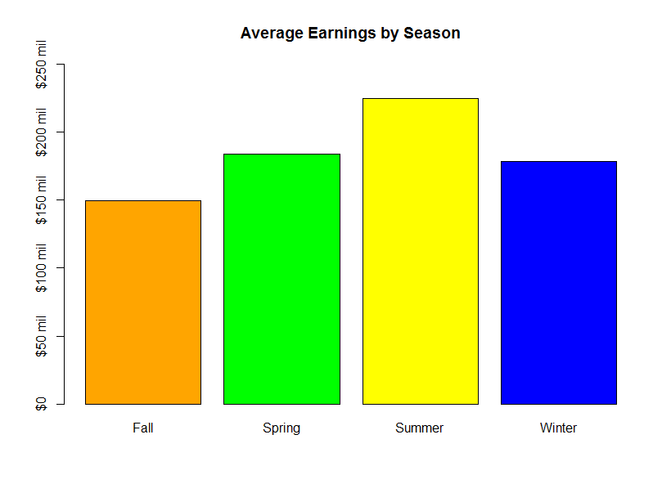
Data Exploration Pt. 2

Slide 5
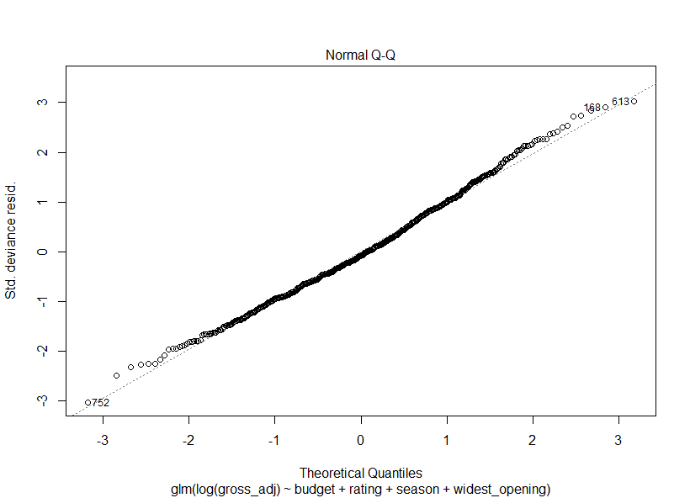
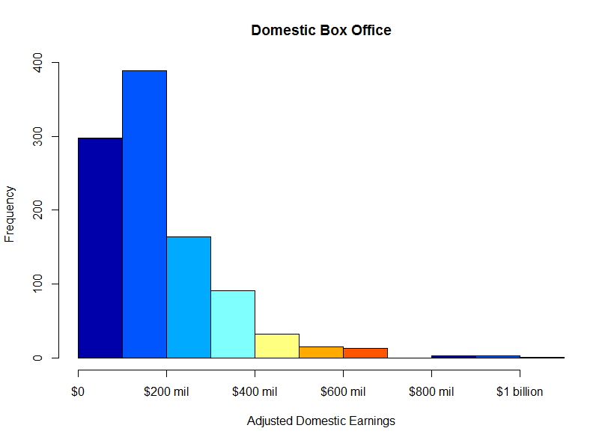
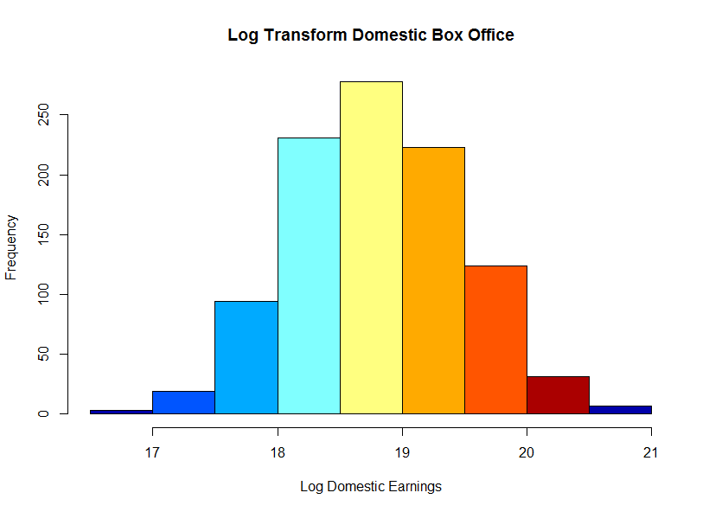
Fitting a Model
Linear Regression
Transforming Data
Limitations

Slide 6
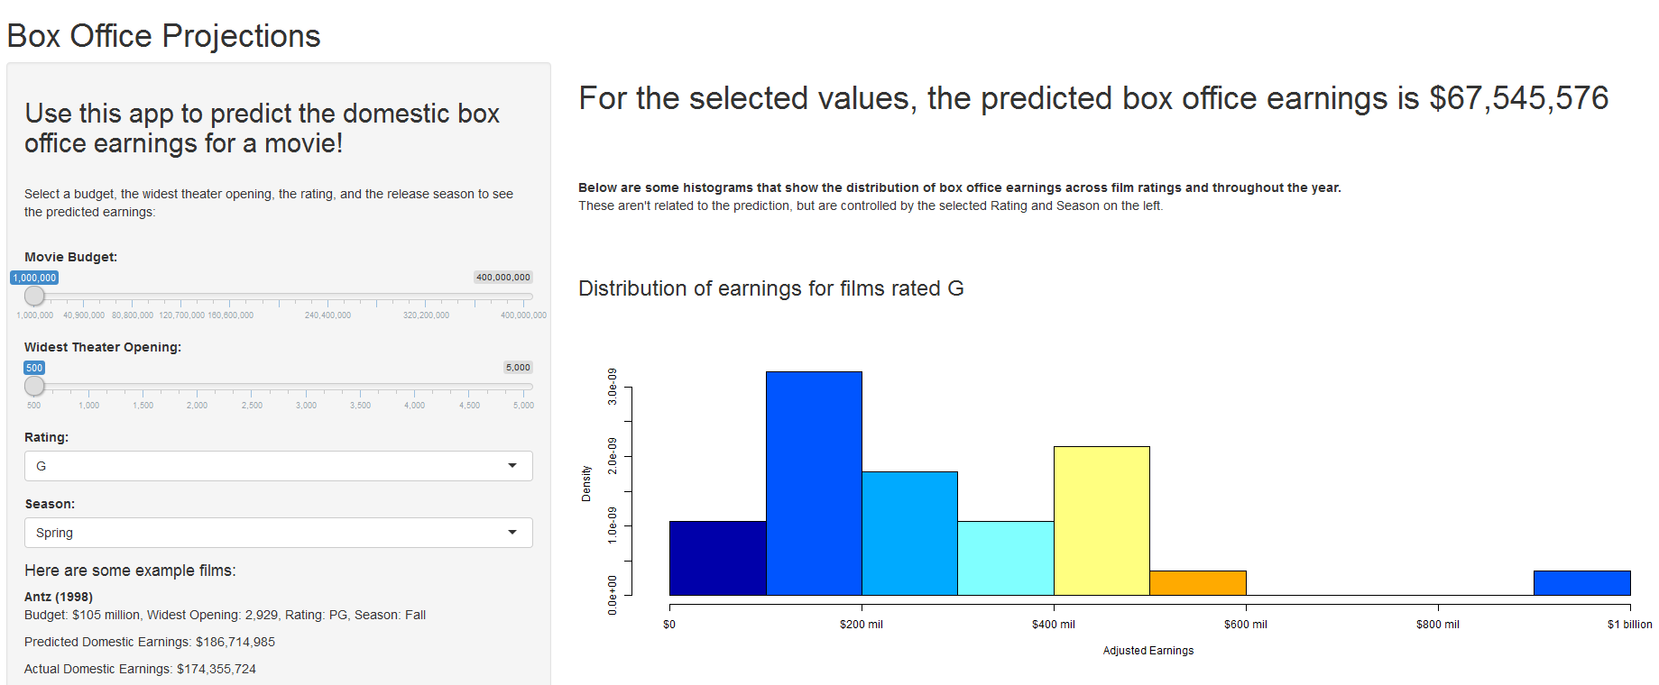
Final App
Can be found here:
https://kalebe.shinyapps.io/Box-Office-Predictions/

